Slide 1

CHAPTERS / CENTRES
MANAGING COMMITTEE PRESENTATION
Presented By – Ms. Sneha Bharti

Slide 2
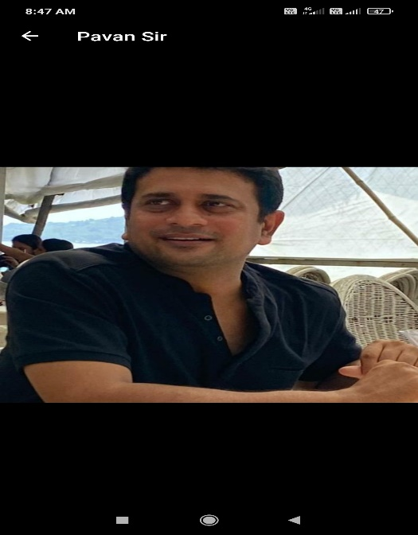
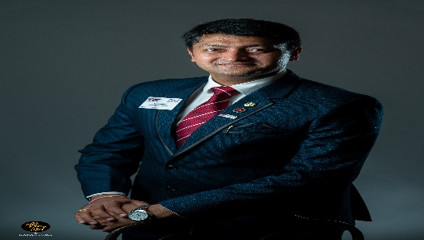
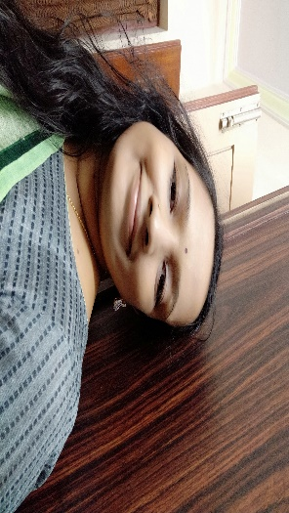
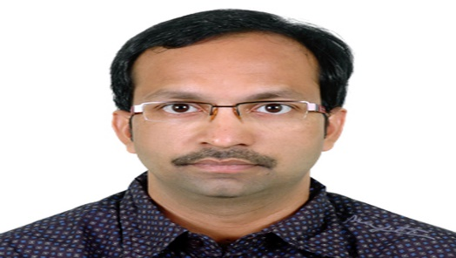
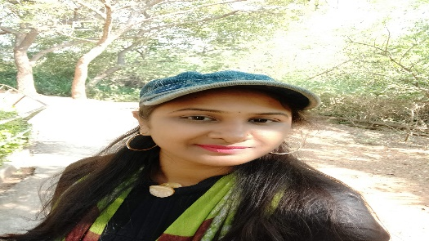
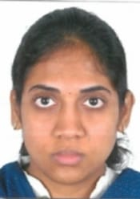
AMRAVATI M.C. 21-23
BLANK
Did not filled up MC google form
CP
Pavan Suryadevara, IPC
Overall Advice/Mentoring
99630 - 67799
info@clarklloyd.com
Jai Desai, VC Trade
Specials Assignments
98851 - 65175
jai.h.desai@gmail.com
Komal Gilda, Hon.Sec.
Sponsorships - Protocol - Compliances
90526 - 36961
komal.gilda@gmail.com
Naga Kaja, Treasurer
Education - CEP
96764 - 04855
nagarajukaja1@gmail.com
Lakshmi S Rachapudi, MC
94909 - 39329
sahityarachapudi@gmail.com
Swati Bhogineni, MC
Specials Assignments
80083 - 35555
swathi.bhogineni@gmail.com
Yahya Mohammad, MC
Specials Assignments
93999 - 92704
faisalmyb@gmail.com

Slide 3
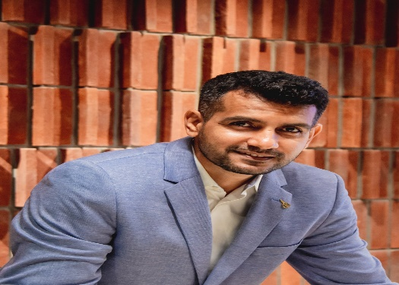
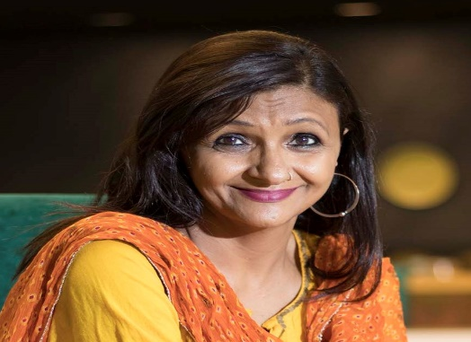
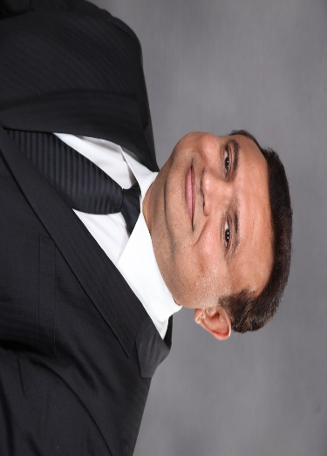
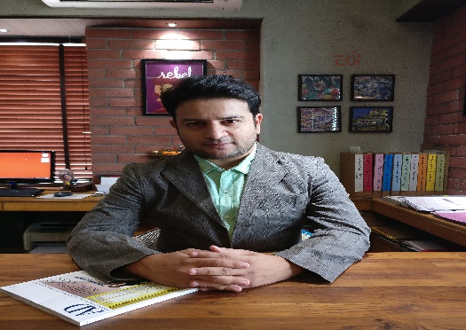
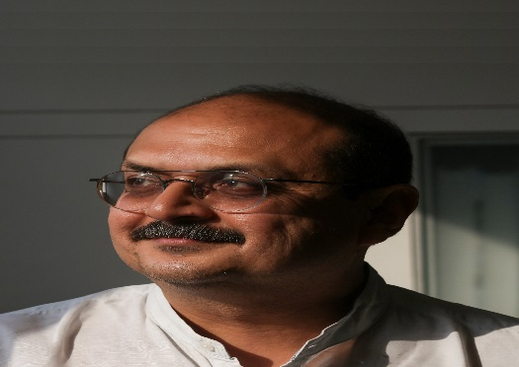
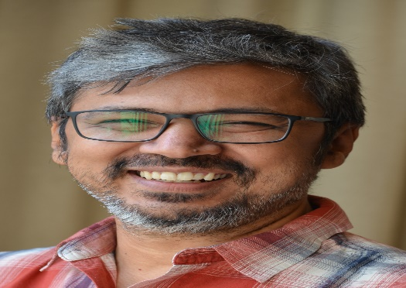
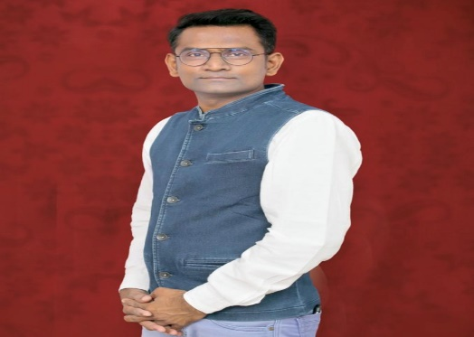
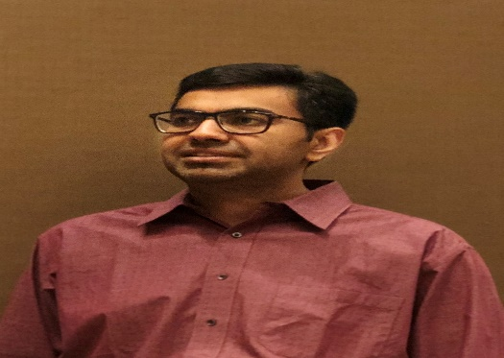
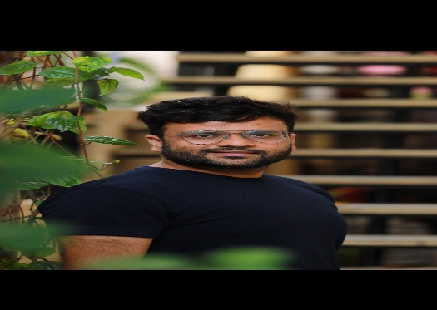
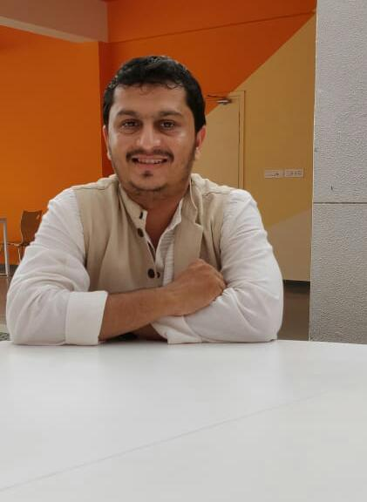
AHMEDABAD M.C. 21-23
Vatsal Joshi, CP
Calendar & Current Affairs
98250 - 12090
vatsal@aapl-architects.org
Devdatt Pandya, CPE
Overall Advice/Mentoring
98792 - 34919
pandya.devdatt@gmail.com
Ranna Parikh, IPC
Overall Advice/Mentoring
98250 - 66486
rannaparikh@yahoo.co.in
Yogesh Thakkar, VC Trade
Sponsorships - Protocol - Compliances
98240 - 38412
Info@yogibis.com
Chirag Doshi, Hon.Sec.
Correspondence - Records –
Constitution
98248 - 04416
egodes@gmail.com
Mehul Dave, JHS
Membership Growth - Arrears
94267 - 02556
mehulmdave@gmail.com
Sujal Khandwala, Treasurer
Funds - Finance - Corporates
98251 - 97937
Spaceplan@balas.in
Premal Nagori, MC
98257 - 24073
premal1998@yahoo.co.in
Khanjan Patel, MC
Print - Press - Media
96876 - 52700
khanjankulin@gmail.com
Nehaal Kinariwala, MC
Education - CEP
97272 - 62929
nehaalkinariwala@gmail.com

Slide 4
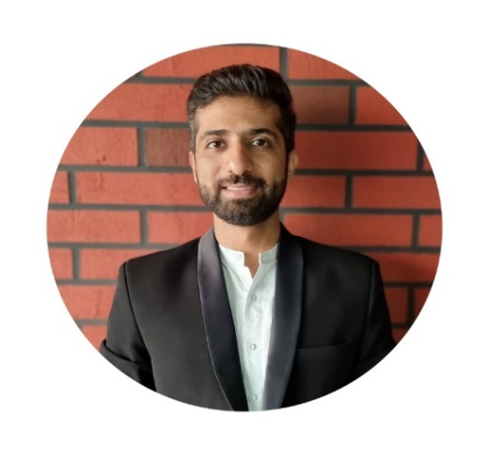
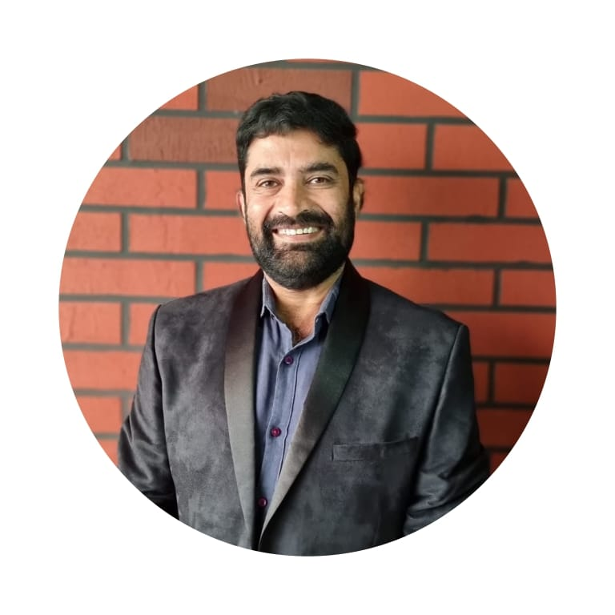
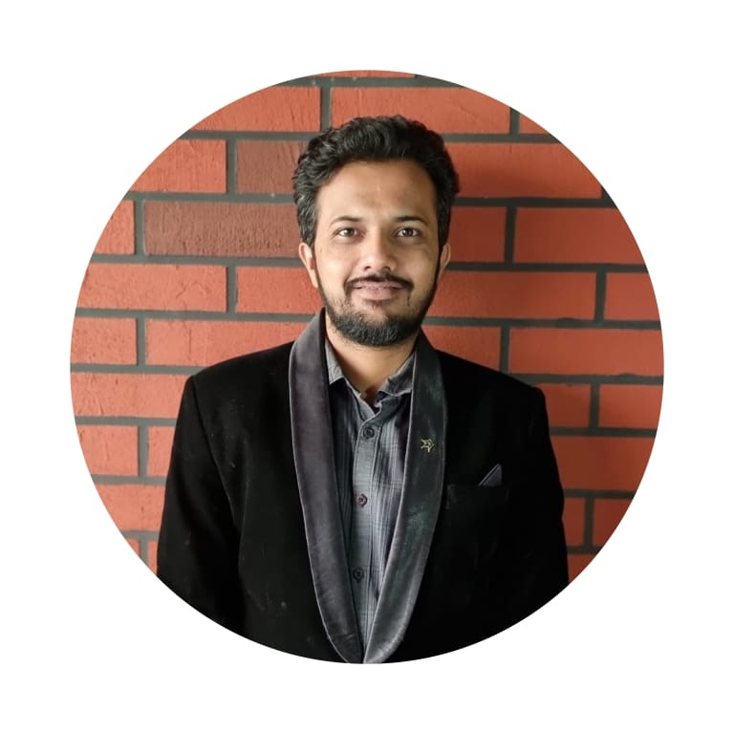
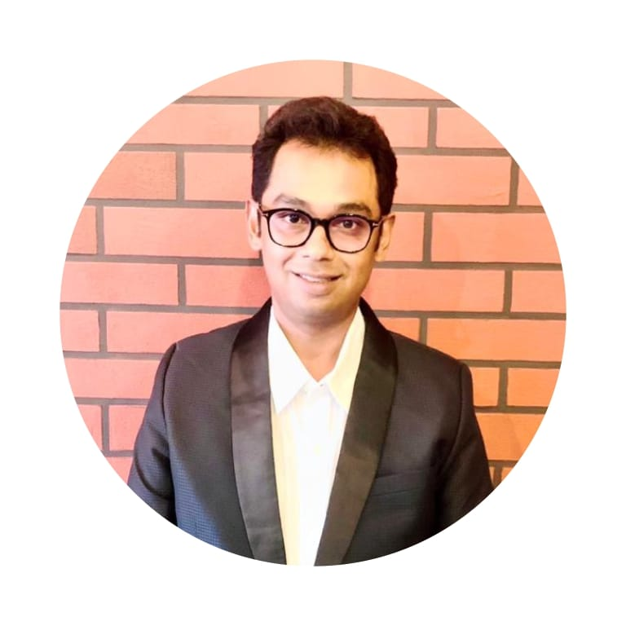
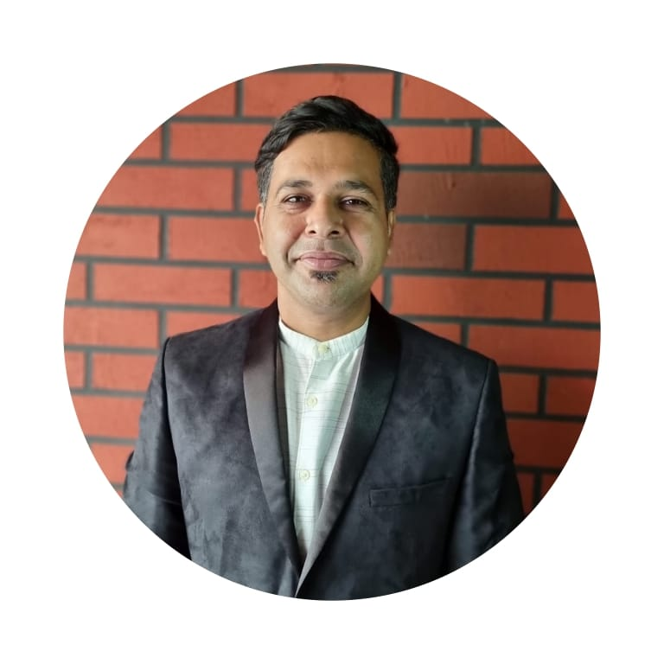
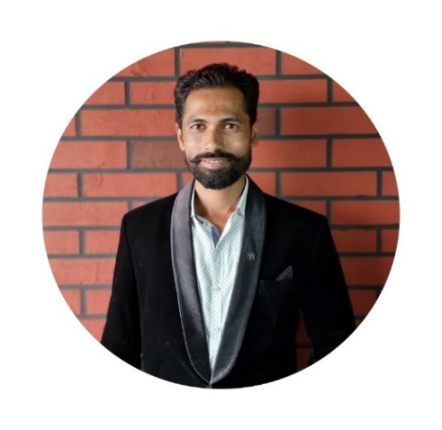
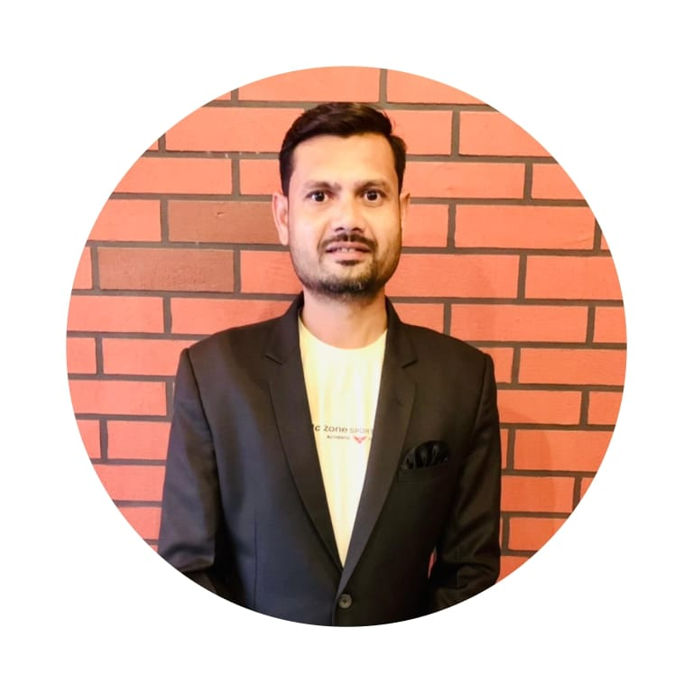
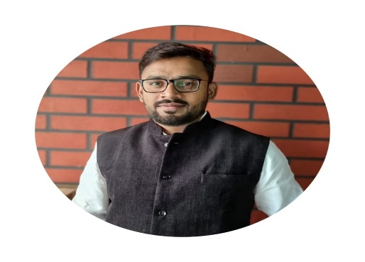
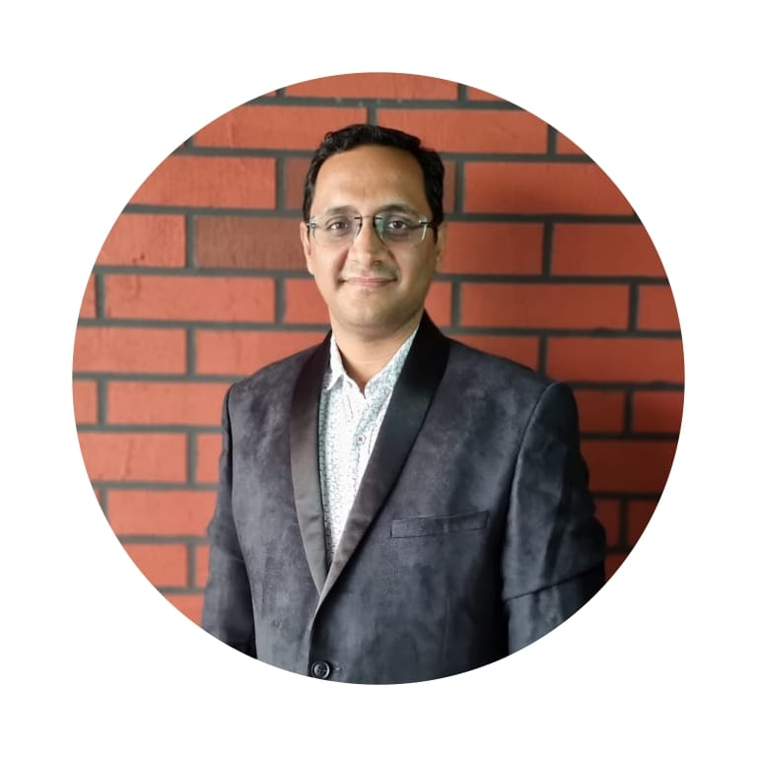
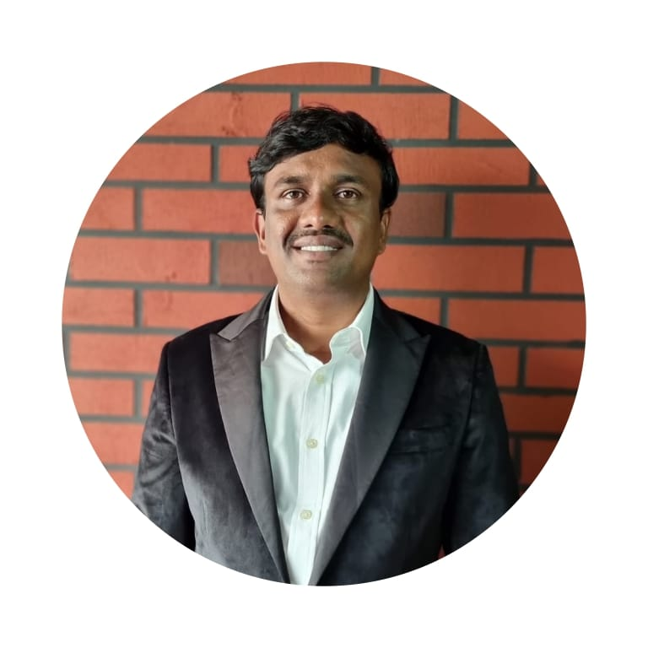
AHMEDNAGAR M.C. 21-23
Ashish Gurnani, CP
9860376799
ashish@gurnaniandassociates.in
Ajay Apurva, CPE
Overall Advice/Mentoring
9822243395
ajayapurva5@gmail.com
Avtarsingh Hira, IPC
Overall Advice/Mentoring
9860388181
havtarsingh@gmail.com
Abhinandan Bhansali, VC Trade
9922817817
rishavlights@gmail.com
Amit Chimnani, Hon. Sec.
9890020520
designgenx@gmail.com
Tejas Darokar, JHS
9096785663
kalpakinteriors17@gmail.com
Sachin Hiwale, Treasurer
Funds - Finance - Corporates
9689435776
Sachin.c_hiwale@rediffmail.com
Suraj Nannaware, MC
Event - Awards - NATCON
9860381818
suraj.nannaware444@gmail.com
Satish Bajaj, MC
Specials Assignments
9175666000
satyamhardware.ahmednagar@
gmail.com
Santosh Gaikwad, MC
Membership Growth - Arrears
9730354532
santoshgaikwad.sg@gmail.com

Slide 5
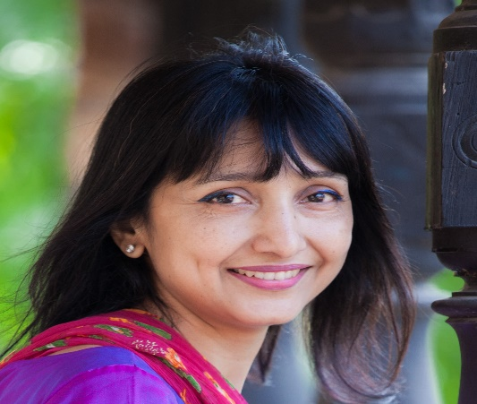
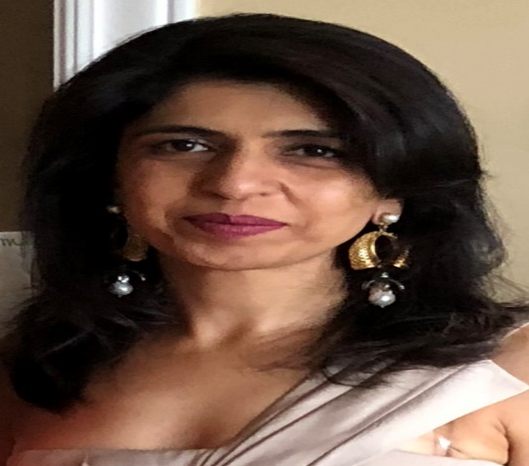
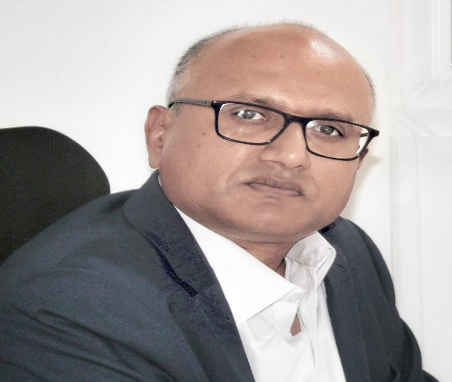
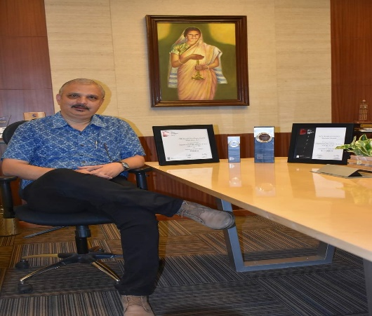
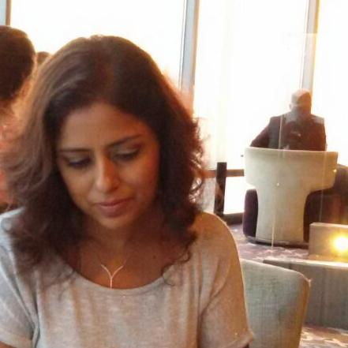
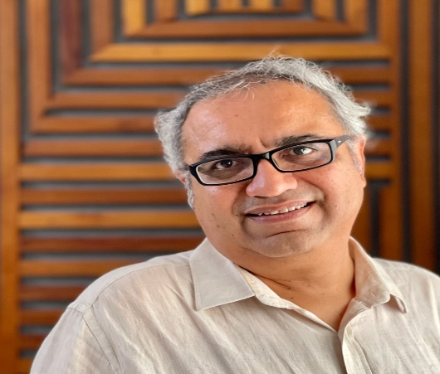
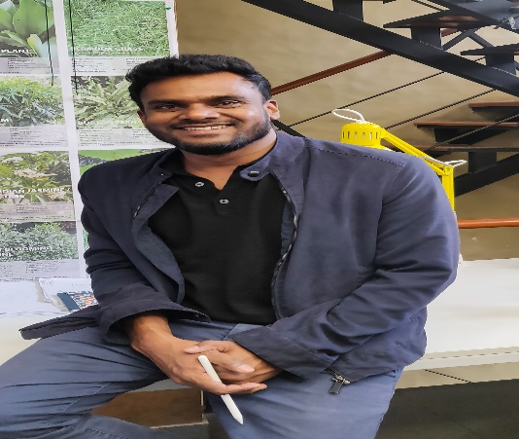
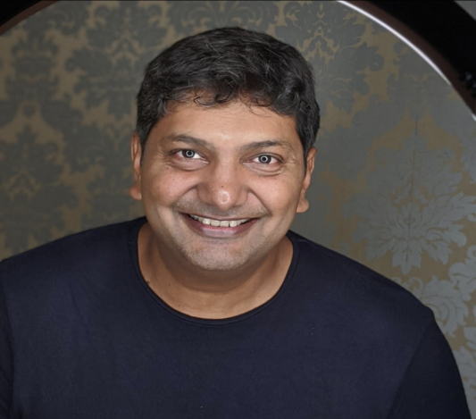
BANGALORE M.C. 21-23
Kavita Sastry, CP
Calendar & Current Affairs
98452 - 51612
kavisastry@gmail.com
Gunjan Das, CPE
Yantra - Portfolio - Weather Report
99860 - 79261
info@ngassociates.in
Prashanth Reddy, VC Trade
Sponsorships - Protocol - Compliances
98451 - 91425
prashanth.reddy@fundermax.biz
Vishwanath Rao, Hon. Sec.
Education - CEP
98450 - 61280
vish@vishwannathassociates.net
Sahana Shetty, JHS
Events - Showcase – Others
90089 - 99013
sahana@coredesignarchitects.com
Vikram Sampat, Treasurer
Specials Assignments
99020 - 21443
livingelements.vikram@gmail.com
Elayaraja Mayavan, MC
Specials Assignments
96633 - 87440
elay@myvn.in
Zubair Ahmed, Co-opt
Specials Assignments
98440 - 31909
zubair@studioplus.in

Slide 6
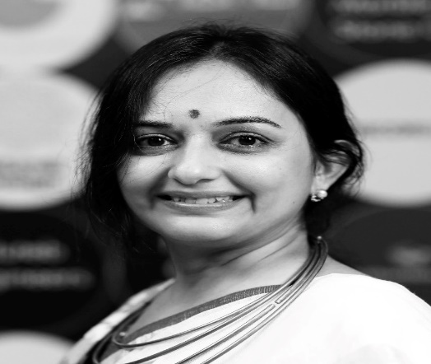
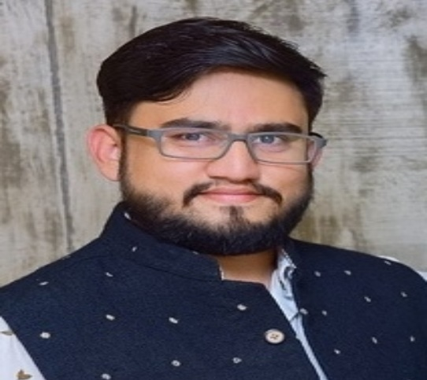
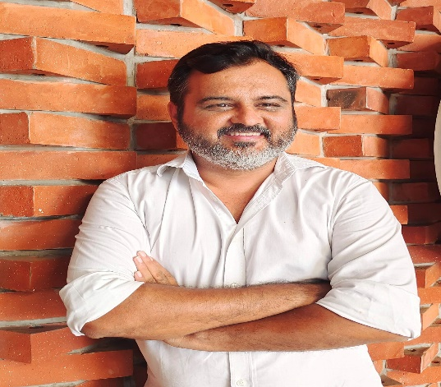
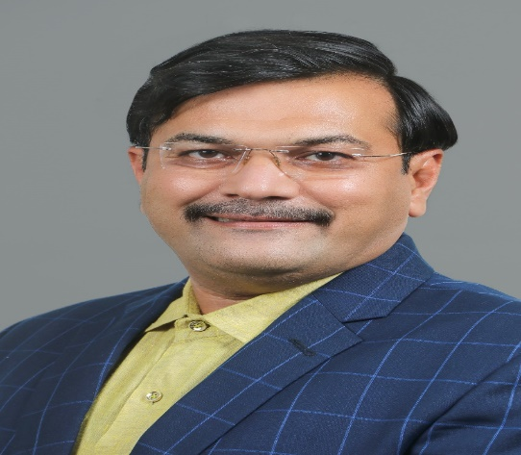
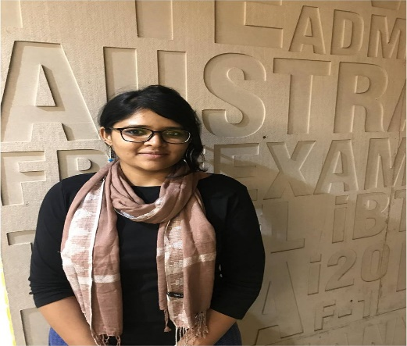
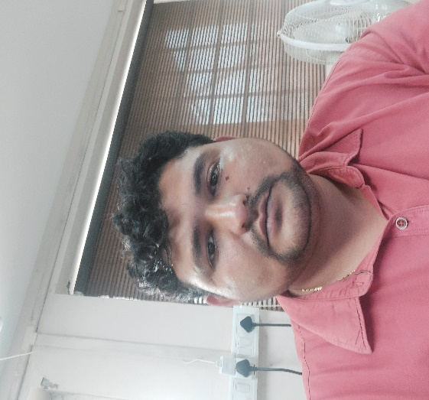
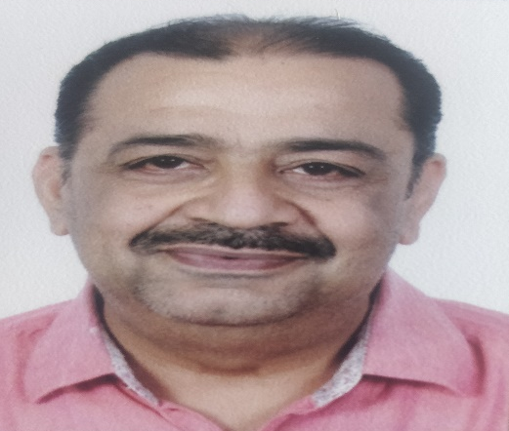
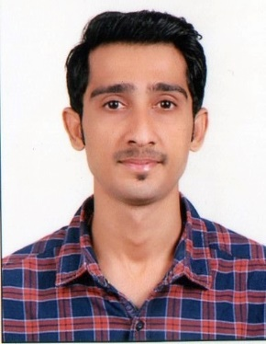
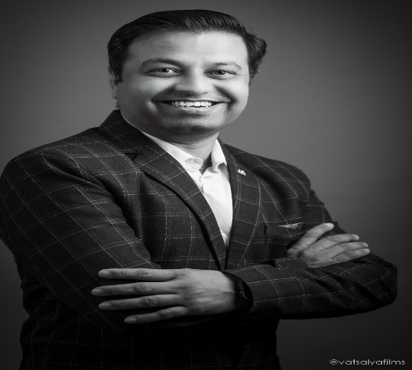
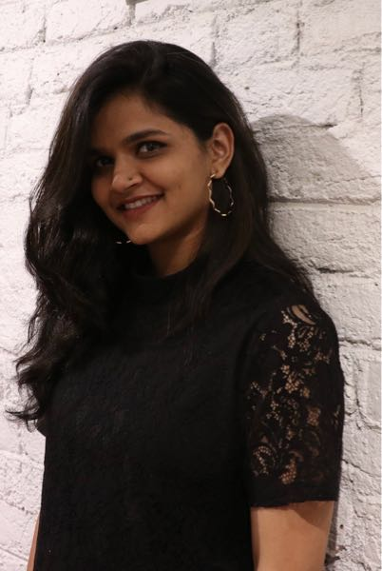
BHARUCH M.C. 21-23
1
Maitri Buch, CP
Calendar & Current Affairs
98241 - 21580
maitrimithaiwala@gmail.com
Shahabuddin Contractor, CPE
Membership Growth - Arrears
96384 - 23930
ar.shahabuddin1982@gmail.com
Chirag Vadgama, IPC
Overall Advice/Mentoring
99740 - 01036
jk.chirag@gmail.com
Pratham Surti, VC Trade
Funds - Finance - Corporates
98980 - 59686
hemantsurti_001@yahoo.com
Vidita Choksi, Hon.Sec.
Events - Showcase - Others
98240 - 34231
design.littlestudio@gmail.com
Manojkumar Kulchandani, Treasurer
Sponsorships - Protocol - Compliances
98250 - 23501
mkulchandani@yahoo.com
Dhruv Mehta, MC
Events - Showcase - Others
81416 - 44666
karyadesignstudio@gmail.com
Virendrasinh Rana, MC
98980 - 84841
designerview1910@gmail.com
Manan Jhaveri, MC
Specials Assignments
98986 - 37606
vibearch@gmail.com
Radha Patel, MC
90994 - 24895
ar.radha.patel@gmail.com

Slide 7
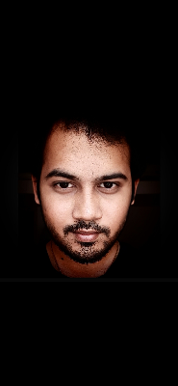
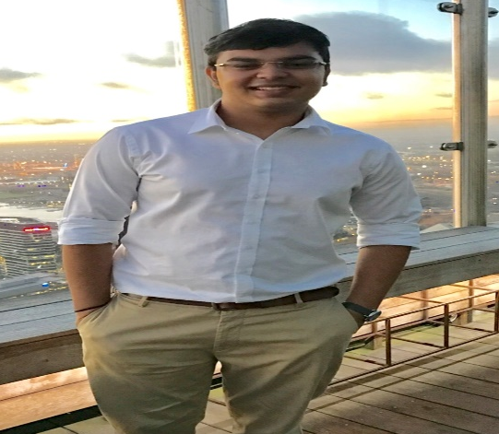
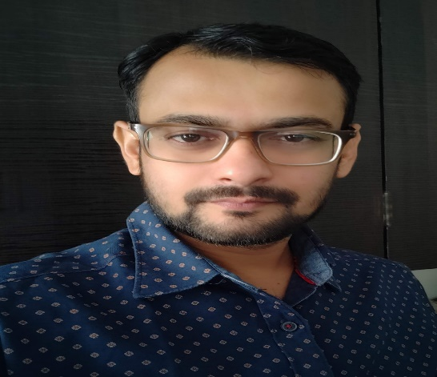
BHARUCH M.C. 21-23
2
Raxit Shah, MC
Event - Awards - NATCON
81606 - 62989
aarunya.archi@gmail.com
Gautam Gandhi, Co-opt
Event - Awards - NATCON
98251 - 40220
gautamgandhi44@gmail.com
Sneh Patel, Co-opt
Specials Assignments
92656 - 71553
sneh@bmworld.in
Kadam Shah, Co-opt
Print - Press - Media
92271 - 35357
kus2in@rediffmail.com

Slide 8
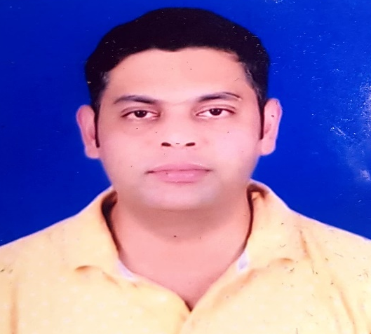
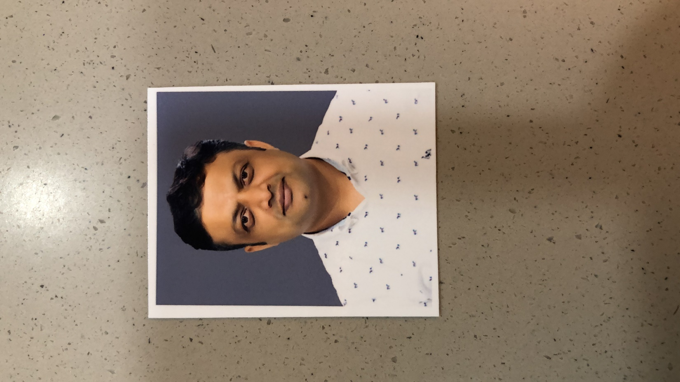
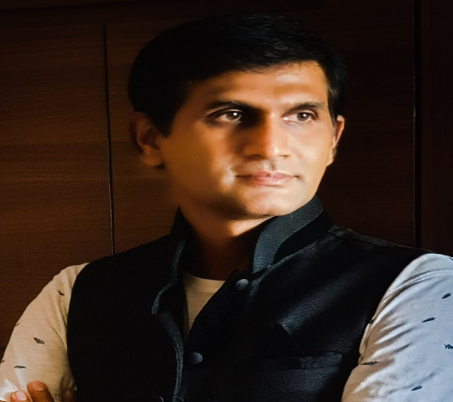






BHOPAL M.C. 21-23
Ravisha Merchant, CP
Overall Advice/Mentoring
98260 - 74691
triveradesigns@gmail.com
Rishi Sahu, CPE
Correspondence - Records - Constitution
89599- 11644
uspdesignstudio@gmail.com
Chetan Patel, VC Trade
Events - Showcase - Others
94250 - 08500
pateltimber1998@gmail.com
Ankush Pathe, Hon.Sec.
Correspondence - Records –
Constitution
94250 - 21176
ankush_pathe@yahoo.com
Manish Gupta, Treasurer
Membership Growth - Arrears
94250 - 09255
maneesh.g17@gmail.com
Mayooree Saxena, MC
Events - Showcase - Others
98270 - 55365
mayooreesaxena@gmail.com
Jeetu Motwani, MC
Membership Growth - Arrears
98262 - 91777
Jeetu91777@gmail.com
Kamalroop Maan, Mentor
Overall Advice/Mentoring
98260 - 59636
kamalroop@gmail.com
Rakesk Jain, Co-opt
Events - Showcase - Others
94250 - 12129
vinsunbpl@gmail.com

Slide 9






CHENNAI M.C. 21-23
Ravimeenakshisundaram, CP
94440 - 11118
ravimeenakshisundaram@yahoo.com
Ravi Pa, CPE
Education - CEP
98427 - 66623
architectravi88@gmail.com
Jeyapandian K, IPC
Overall Advice/Mentoring
93452 - 59058
arjeyam@gmail.com
Sakthinarayanan R, VC Trade
98410 - 22284
sakthi@yman.in
Praneeta Varma, Hon.Sec.
Correspondence - Records - Constitution
97898 - 02786
praneeta@d-studio.in
Kunnakudi Kunnakudi, Advisor
96000 - 59567
kvshrini@gmail.com

Slide 10







CHAROTAR M.C. 21-23
Atish Patel, CP
Yantra - Portfolio - Weather Report
97128 - 52834
aatish3097@gmail.com
Mrunal Patel, CPE
Sponsorships - Protocol - Compliances
95379 - 40431
Mrunal_patel99@yahoo.in
Nirav Vaghela, IPC
Membership Growth - Arrears
99250 - 48440
yaam.architects@gmail.com
Gopal Patel, Hon.Sec.
Print - Press - Media
70692 - 49499
gopalpatel35@gmail.com
Snehal Patel, Treasurer
Events - Showcase - Others
99789 - 99955
akiramarbles@gmail.com
Devyani Shrivastava, MC
94090 - 11211
ar.devyanishrivastava@gmail.com
Rachita Patel, MC
99250 - 08888
design@ergodnovate.com

Slide 11





COIMBATORE M.C. 21-23
Geetha Rani, CP
Calender & Current Affairs
98428 - 71873
ar_geethakarthikeyan@yahoo.com
Arun Prakashan, CPE
9443020302
arunandassociates@gmail.com
Marappan Bhuvanasundar, IPC
98430 - 11995
ssarchcbe@gmail.com
Rajan Bathija, VC Trade
98430 - 30623
mrlightcbe@gmail.com
Rajagopalan Kumaranguru, Hon.Sec.
Correspondence - Records – Constitution
91596 - 89163
gopal.rho@gmail.com
Jayashree S, Treasurer
Funds - Finance – Corporates
96009 - 29209
studio29@gmail.com
Sasi Kumar A, MC
98946 - 59698
ar.sasi@gmail.com
Nirmal Meethalal, MC
99523 - 07025
nirmalrinku@gmail.com
G Sridevi, MC
97877 - 22322
architectsridevi2014@gmail.com

Slide 12





CHANDIGARH M.C. 21-23
Ashima Vashisht, CP
Calendar & Current Affairs
98147 - 11077
Iiidchandigarh@gmail.com
Sudha Ojha, Hon.Sec.
Specials Assignments
98145 - 12037
sudhaojha11@gmail.com
Harmeet Singh, Treasurer
99155 - 28999
Coolways.chd@gmail.com
Harleen Virk, MC
Education - CEP
98148 - 10050
harleenvirk1001@yahoo.co.in
Manuj Shardia, MC
Membership Growth - Arrears
98168 - 01919
architectmanuj@gmail.com

Slide 13





DELHI M.C. 21-23
Hemant Sud, CP
Print - Press - Media
98102 - 64641
hemantsud26@gmail.com
Rishu Anand, CPE
98913 - 10414
Rishu_anand@hotmail.com
Samir Gupta, VC Trade
Events - Showcase - Others
93501 - 70466
samir.gupta@samtechinfonet.com
Ravikumar M B, Treasurer
Correspondence - Records - Constitution
98100 - 71924
raviqumar@gmail.com
Madhu Kumar, MC
Specials Assignments
98110 - 55124
madhuqumar@gmail.com
Kshitij Bansal, Co-opt
98116 - 14134
Bansal.opmk@gmail.com

Slide 14










GOA M.C. 21-23
1
Krishna Phaldesai, CP
98504 - 59859
krishnaphaldesai@gmail.com
Sumed Naik, CPE
98238 - 36768
naiksumedh@gmail.com
Sidharth Naik , IPC
94220 - 57917
ulysisgoa@gmail.com
Fauzia Farooqui, VC Trade
78751 - 20176
fauzia.khanfarooqui@gmail.com
Pallavi Satardekar, Hon.Sec.
98504 - 52774
parijatdesign@gmail.com
Siddharth Deshpande, Treasurer
Funds - Finance - Corporates
98229 - 18573
siddharth.1855@gmail.com
Jayesh Phadte, MC
98221 - 20118
archjayesh.ofc@gmail.com
Guruprasad Mantravadi, MC
Overall Advice/Mentoring
98221 - 04857
Futuristichabitat@yahoo.co.in
Anagha Fernandes, MC
88888 - 48100
anaghaferns74@gmail.com
Rajesh Kenkre, MC
94220 - 62723
i@rajeshkenkre.com

Slide 15


GOA M.C. 21-23
2
Pravin Pai Lotlikar, Co-opt
98232 - 84851
floors_walls@yahoo.com
Sheetal Morajkar, Co-opt
98231 - 27959
ssmdesigns77@gmail.com

Slide 16









HYDERABAD M.C. 21-23
1
Manoj Wahi, CP
Overall Advice/Mentoring
98480 - 34575
manoj@designerweb.in
Pallavi Anchuri, CPE
Specials Assignments
98490 - 07272
anchuripallavi@yahoo.in
Nanda Birudavolu, IPC
88868 - 95454
archnanda@yahoo.com
Jaleel Sabir, VC Trade
99080 - 22333
jaleel@mahavirsoundroom.com
Praveen N, Hon.Sec.
92461 - 59395
info@trudesigns.in
Naveen Chalasani, JHS
Events - Showcase - Others
99499 - 92146
navin.yd@gmail.com
Rakesh Vasu Chokka Suresh, Treasurer
Events - Showcase - Others
98490 - 05400
vasucsr@gmail.com
Sanjana Shah, MC
Events - Showcase - Others
99665 - 13000
bnisanjana@gmail.com
Gaurav Pershad, MC
99897 - 18585
gauravpershad@gmail.com
Venkata Nalam, MC
9246523756
nalamsubbarao@gmail.com

Slide 17


HYDERABAD M.C. 21-23
2
Mohammed Shareef, Co-opt
Specials Assignments
osman.shareef@haworth.com
Sushmita Subudhi, Co-opt
Education - CEP
94403 - 07336
sushmitasubudhi@gmail.com

Slide 18










INDORE M.C. 21-23
1
Shital Kapade, CP
88898 - 33341
indoreiiidchairperson@gmail.com
Abhishek Julka, CPE
98270 - 05557
abhishek.Julka@yahoo.co.in
Naeemuddin Qureshi, IPC
Overall Advice/Mentoring
98260 - 78617
n69q@yahoo.co.in
Amit Singhal, VC Trade
96300 - 44834
m.s.nterprises@gmail.com
Vikas Thakkar, Hon.Sec.
98260 - 49063
vtarch@gmail.com
Jagjeet Tuteja, JHS
98260 - 11766
jagjeetdesignstudio@gmail.com
Nupur Namjoshi, Treasurer
9926025025
nupurnamjoshi@hotmail.com
Bhumika Chainani, MC
Education - CEP
99937 - 84084
eleganteriors@gmail.com
Manogya Gupta, MC
99076 - 67777
ar.manogyagupta@gmail.com
Manogya Gupta, MC
99076 - 67777
Ar.manogyagupta@gmail.com

Slide 19


INDORE M.C. 21-23
2
Sunita Agrawal, Co-opt
97541 - 93793
sunitaagrawal.68@gmail.com
Naveen Wadhwani, Co-opt
98930 - 37377
naveenwadhwani18@gmail.com
Vikram Batra, Co-opt
93018 - 35550
theconcept555@gmail.com

Slide 20










JAIPUR M.C. 21-23
1
Sheetal Agrawal, CP
Calendar & Current Affairs
98290 - 61013
Sh.kumarag@gmail.com
Kshitiz Manu, CPE
Overall Advice/Mentoring
70751 - 11111
kmanuassociates@gmail.com
Anshuman Sharma, IPC
Overall Advice/Mentoring
99838 - 31453
anshrafa@gmail.com
Tulsi Modi, VC Trade
Specials Assignments
99283 - 01222
tulsi.modi@rsiipl.com
Ashish kala, Hon.Sec.
Correspondence - Records –
Constitution
98290 - 64096
kalaandassociates@gmail.com
Manish Thakuriya, JHS
Membership Growth - Arrears
94141 - 99726
aestheticpointjaipur7@gmail.com
Sandeep Jain, Treasurer
Specials Assignments
94140 - 73496
thelanternjaipur@gmail.com
Shikha Singh, MC
82336 - 88000
Shikha.singhs.id@gmail.com
Juhi Kedia, MC
99285 - 52759
juhikedia08@gmail.com
Anshul Modi, MC
Events - Showcase - Others
94620 - 02766
anshulmodi@sskg.co.in

Slide 21


JAIPUR M.C. 21-23
2
Sunil Jain, Co-opt
Membership Growth - Arrears
9828117586
sunil@designspaceconsultants.com
Vivek Gupta, Co-opt
90011 - 00007
vivek@aadityaretails.com

Slide 22








KERALA M.C. 21-23
Sandhya Mohanda, CP
Calendar & Current Affairs
97450 - 50047
mail@sandhyaandassociates.com
Ikbal Chozhiyattel, CPE
Yantra - Portfolio - Weather Report
94473 - 81179
iq.architects5@gmail.com
George Mathai, IPC
Overall Advice/Mentoring
98950 - 66009
georgemathai777@gmail.com
Venu Bhaskaran Nair, VC Trade
Sponsorships - Protocol - Compliances
98470 - 69669
Venu@avantikainteriors.com
Shyam P, Hon.Sec.
Correspondence - Records - Constitution
98954 - 04502
formsandspaces@gmail.com
Aabid Raheem, JHS
85899 - 31993
aabidraheem@gmail.com
Sunita Varghese, Treasurer
Funds - Finance - Corporates
92077 - 65401
Sjv@luxrays.com
Faizal pw Faizal, MC
Overall Advice/Mentoring
98952 - 22003
faizal222003@gmail.com

Slide 23







KOLHAPUR M.C. 21-23
Chandan Mirajkar, CP
93711 - 00903
idchandanmirajkar@gmail.com
Prashant Patil, CPE
Event - Awards - NATCON
94224 - 27287
prashaantsdesign@gmail.com
Sharad Pawar, VC Trade
98225 - 33448
nirmantraders@gmail.com
Sachin Bora, JHS
94224 - 12292
mayurconsultants@gmail.com
Kishor Patil, Treasurer
94220 - 46374
Siddhesharchitects@yahoo.co.in
Gaurav Kakade, MC
94232 - 85824
kgaurav3654@gmail.com
Abhijeet, MC
Membership Growth - Arrears
98226 - 78717
abhichavan7176@gmail.com

Slide 24










LUCKNOW M.C. 21-23
Vishal Jain, CP
Membership Growth - Arrears
93354 - 96852
vishal.nirvana@gmail.com
Prasenjit Sanyal, CPE
Yantra - Portfolio - Weather Report
94154 - 65793
Subhadesigners30@gmail.com
Sandeep Saraswat, IPC
Overall Advice/Mentoring
92356 - 90191
sksaraswat.lko@gmail.com
Sanjay Mittal, VC Trade
Sponsorships - Protocol - Compliances
98386 - 34341
sanjay@harshplywood.com
Aviral Agarwal, Hon.Sec.
Correspondence - Records –
Constitution
97931 - 26000
asimetricconsultants@gmail.com
Parul Gurha, JHS
Event - Awards - NATCON
80521 - 96000
parulgurha2018@gmail.com
Rohit Gupta, Treasurer
Funds - Finance - Corporates
98398 - 80410
rohit.nirvana2@gmail.com
Anurag Jain, MC
Specials Assignments
98380 - 30694
ar.anurag.apeejay@gmail.com
Neeraj Kushwaha, MC
Sponsorships - Protocol - Compliances
94522 - 69789
Arckitect@icloud.com
Fouzan Khan, MC
Events - Showcase - Others
97953 - 25649
ar.fouzan@eminentarch.com

Slide 25









MARATHWADA M.C. 21-23
Anjali Kabra, CP
Calender & Current Affairs
98227 - 60161
anjalisdesigns@gmail.com
Sharwari Deshpande, IPC
Correspondence - Records - Constitution
9657144669
sdj3006@gmail.com
Gajanan Chavan, VC Trade
Membership Growth - Arrears
94227 - 04599
Gajanan.chavan1978@gmail.com
Daksha Shroff, Hon.Sec.
Sponsorships - Protocol - Compliances
82753 - 88466
dakswap@gmail.com
Vipul Patel, Treasurer
Funds - Finance - Corporates
98228 - 57957
vipulpatel857957@gmail.com
Lamikant Surve, MC
Events - Showcase - Others
94222 - 07006
laxmikantsurve9@gmail.com
Swapnil Shroff, MC
94222 - 07005
ar.swapnilshroff@gmail.com
Anant Deshpande, Mentor
Overall Advice/Mentoring
98228 - 44669
ifmaa1@gmail.com
Rajan Nadkarni, Mentor
Overall Advice/Mentoring
89755 - 50001
nadkarnirv@gmail.com

Slide 26










MUMBAI M.C. 21-23
Hasmukh Shah, CP
Yantra - Portfolio - Weather Report
93241 - 81155
hs.adlgroup@gmail.com
Ketan Sheth, CPE
Sponsorships - Protocol - Compliances
98200 - 62481
ketan@goldmine99.com
Harwinder Matharoo, VC Trade
98210 - 38479
hmd.inn@gmail.com
Mehul Kamdar, Hon.Sec.
91672 - 55337
iiidmrcsecretary@gmail.com
Pranav Desai, JHS
98202 - 96192
pranav@iagconsultants.com
Rajesh Modak, Treasurer
Funds - Finance - Corporates
98200 - 72093
depth19@rediffmail.com
Rajiv Harsora, MC
Membership Growth - Arrears
98201 - 48320
rajivharsora@gmail.com
Ateet Vengurlekar, MC
Education - CEP
98200 - 74471
architect.ateet@gmail.com
Pritesh Meisheri, MC
Education - CEP
98208 - 12799
pritesh@pritdesigners.com
Paras Bhuta, Co-opt
Specials Assignments
98210 - 63779
paras@tulipcorporation.net

Slide 27






MANGALORE M.C. 21-23
Mohammed Nissar, CP
Correspondence - Records - Constitution
98457 - 65364
Nissarm@abuildinglab.com
Dr Prasanth A, VC Trade
98454 - 36365
drprasanthma@appleplywoods.com
Sharun Anchan, Hon.Sec.
99800 - 37828
ar.sharun@gmail.com
Ramnath Nayak, JHS
Education - CEP
95353 - 25606
ar.ramnath.nayak@gmail.com
Meraj Yusuf, MC
96865 - 99099
Interiors@inlandindoors.com
Sonal Rao, MC
9663 - 39800
sonalshettyrao@yahoo.com

Slide 28









PUNE M.C. 21-23
1
Anjali Badi, CP
Calender & Current Affairs
98228 - 45763
anjali_badi@yahoo.com
Ajay Panchamatia, CPE
Membership Growth - Arrears
98220 - 63578
nupoor.ai@gmail.com
Ganeshkumar Wable, IPC
Overall Advice/Mentoring
98817 - 09999
ganeshkumarwable@gmail.com
Rajesh Kurade, VC Trade
Sponsorships - Protocol - Compliances
88887 - 12345
rajesh@impulsetrend.com
Mahesh Bangad, Hon.Sec.
Correspondence - Records - Constitution
99757 - 09665
mahesh.bnca@gmail.com
Rajesh Puranik, JHS
Funds - Finance - Corporates
98220 - 31956
rajeshpuranik@yahoo.com
Rajesh Mungee, Treasurer
Funds - Finance - Corporates
82370 - 93405
rajamungee@gmail.com
Unmesh Mistry, MC
Membership Growth - Arrears
98230 - 33003
designcubbe03@gmail.com
Harpriit Aanaand, MC
Specials Assignments
98506 - 61642
vidaindoor@gmail.com
Mayuri Bhakay, MC
Print - Press - Media
98220 - 06799
mayuri.leo@gmail.com

Slide 29





PUNE M.C. 21-23
2
Aditya Arole, Co-opt
Specials Assignments
98232 - 71235
arole.aditya@gmail.com
Rahul Oswal, Co-opt
Membership Growth - Arrears
98900 - 17335
rahulcitiply@gmail.com
Rahul Chordiya, Co-opt
Events - Showcase - Others
93710 - 06275
info.sayyam@gmail.com
Omkar Agashe, Co-opt
86001 - 41441
omagashe@gmail.com
Anuja Pandit, Co-opt
Event - Awards - NATCON
98229 - 74114
anuja.pan@gmail.com

Slide 30










NASHIK M.C. 21-23
Vaishali Pradhan, CP
98900 - 95322
vrparch@gmail.com
Atul Bohora, CPE
Events - Showcase - Others
98221 - 98908
atulbohora@gmail.com
Tarannum Kadri, IPC/Advisor
Events - Showcase - Others
98224 - 78476
tarannumkadri@gmail.com
Jitendra Batavia, VC Trade
Education - CEP
98220 - 84048
plywoodcorporation@yahoo.co.in
Rupali Jaykhedkar, Hon.Sec.
Education - CEP
98226 - 62505
jaykhedkar@hotmail.com
Sagar Kabre, JHS
Sponsorships - Protocol - Compliances
94222 - 52477
Sagarakabre@gmail.com
Hakim Sinnerwala, Treasurer
Finance & Membership
98229 - 41152
hakim51152@gmail.com
Shital Sakhala, MC
Cultural & Sports
99222 - 65554
arsakhalass@gmail.com
Smita Wani, Co-opt
Sponsorships - Protocol - Compliances
98230 - 12842
arsmita1@gmail.com
Sudeep Lodha, Co-opt
Sponsorships - Protocol - Compliances
75880 - 24928
sudeep.lodha@gmail.com

Slide 31








NAGPUR M.C. 21-23
1
Arundhati Sathe, CP
Overall Advice/Mentoring
98604 - 16576
arundhati@callistainteriors.in
Himanshu Thakkar, CPE
94217 - 00665
archhimanshu4@gmail.com
Bhushan Jeswani, IPC
Overall Advice/Mentoring
93731 - 06508
jeswanibhushan@gmail.com
Harshal Charde, VC Trade
Membership Growth - Arrears
98230 - 67804
himalayasales@rediffmail.com
Aarti Shahane, Hon.Sec.
Print - Press - Media
98232 - 55515
aarti@archmeraki.com
Seema Agrawal, Treasurer
Sponsorships - Protocol - Compliances
98224 - 74365
seemanagrawal@yahoo.com
Jawahar Tidke, MC
Overall Advice/Mentoring
93266 - 57395
shubhamsales700@gmail.com
Krishna Poddar, MC
Print - Press - Media
93714 - 10720
Krishnapoddar25@gmail.com

Slide 32



NAGPUR M.C. 21-23
2
Abhilasha Sharma, MC
Print - Press - Media
98234 --60000
abhiartland@gmail.com
Tripti Agrawal, MC
98224 - 83143
truptiagrawal17@yahoo.com
Dilip Hinge, MC
Membership Growth - Arrears
93267 - 28494
ar.diliphhingr@gmail.com

Slide 33









RAIPUR M.C. 21-23
Shilpi Sonar, CP
Overall Advice/Mentoring
91650 - 00020
shilpisonar.67@gmail.com
Atul Deshpande, CPE
88786 - 14200
dna.raipur@gmail.com
Rupal Bagrecha, IPC
Overall Advice/Mentoring
94255 - 04083
bagrechaassociates1@yahoo.co.in
Hitesh Oswal, VC Trade
Calendar & Current Affairs
96300 - 05551
hit020@gmail.com
Swapnil Jaggi, Hon.Sec.
Overall Advice/Mentoring
95893 - 48700
swapniljaggi@gmail.com
Nisha Hotwani, Treasurer
99777 - 17158
nishahotwani18@gmail.com
Milan Thakkar, Co-opt
Overall Advice/Mentoring
93291 - 11111
milan.thakkar11@gmail.com
Lokesh Chabdraker, Co-opt
Event - Awards - NATCON
98262 - 49555
Crecons.9@gmail.com
Ruchi Seth, Co-opt
Specials Assignments
78289 - 88755
ruchiseth75@gmail.com

Slide 34










SAURASHTRA M.C. 21-23
1
Shailee Trivedi, CP
Overall Advice/Mentoring
99786 - 02736
trivedishailee@gmail.com
Rachesh Pipaliya, CPE
Events - Showcase - Others
90990 - 51151
racheshpipaliya@gmail.com
Haresh Parsana, IPC/Advisor
Sponsorships - Protocol - Compliances
98252 - 17131
hareshparsana@yahoo.comcd
Jagdish Hariyani, VC Trade
Overall Advice/Mentoring
99094 - 20029
the_transparency@hotmail.com
Darshita Joshi, Hon.Sec.
Event - Awards - NATCON
76000 - 46447
idreamcreator@gmail.com
Vishal Patoliya, JHS
Specials Assignments
94275 - 63975
vishal.patoliya@gmail.com
Jignesh Dhranga, Treasurer
Funds - Finance - Corporates
96629 - 00777
jigneshdhranga26@gmail.com
Viral Patel, MC
Specials Assignments
98985 - 91268
sparsh.designs1@gmail.com
Dipak Mehta, MC
Events - Showcase - Others
98242 - 13280
dpk.mht2000@gmail.com
Kushal Shah, MC
Print - Press - Media
90990 - 23789
architectkushal@gmail.com

Slide 35


SAURASHTRA M.C. 21-23
2
Tejas Raval, Co-opt
Specials Assignments
98242 - 22848
info@tejglass.com
Hardik Lakhani, Co-opt
Events - Showcase - Others
98259 - 97403
ar.hardiklakhani@gmail.com

Slide 36








SURAT M.C. 21-23
1
Rupesh Kapadia, CP
Calender & Current Affairs
98251 - 17111
chairman.iiidsurat@gmail.com,
roops31@yahoo.co.uk
Vishal Masruwala , IPC
Overall Advice/Mentoring
98255 - 44114
architectvishal@yahoo.co.in
Rahul Jaiswal, VC Trade
98241 - 44670
prabhusurat@yahoo.com
Sohel Mansur, Hon.Sec.
Correspondence - Records –
Constitution
98241 - 86962
architectssim@gmail.com
Arpan Chaudhary, JHS
Events - Showcase - Others
98241 - 44075
ideasdesignerspace1@gmail.com
Ashish Patel, Treasurer
98240 - 50229
patel.aashish@ymail.com
Bhavna Vimawala, MC
Education - CEP
98791 - 99126
bhavna.vimawala@gmail.com
Pallav Khandwalla, MC
Overall Advice/Mentoring
98241 - 53082
Info@shipraenterprise.com
Ami Merchan, MC
Print - Press - Media
94261 - 37748
a3merchant@hotmail.com
Vaishali Chauhan, MC
98243 - 56780
chauhanvaishaliv@gmail.com

Slide 37


SURAT M.C. 21-23
2
Vipul Nakrani, Co-opt
98251 - 13939
vipulnakrani@gmail.com
Jigar Talati, Co-opt
Specials Assignments
98251 - 43221
jigar.interiors@gmail.com

Slide 38









THANE M.C. 21-23
1
Sandeep Joshi, CP
Overall Advice/Mentoring
93720 - 33055
sandeep@promkraft.com
Rashmi Tiwari, CPE
Overall Advice/Mentoring
90821 - 62406
Tiwari.rashmi11@gmail.com
Sanjiv Thakur, IPC/Advisor
Overall Advice/Mentoring
98200 - 90037
sanjivthakur07@gmail.com
Mahesh Pednekar, VC Trade
Events - Showcase - Others
98201 - 99428
mahesh_enterprise@rediffmail.com
Manjusha Shresth, Hon.Sec.
Correspondence - Records – Constitution
98209 - 50138
transformationdesignstudio11@
gmail.com
Bobbie Vijayakkar, Treasurer
Education - CEP
982009373
bobbievijayakkar@gmail.com
Shrreyash Sarmalkar, MC
Print - Press - Media
98202 - 46186
essquare46@gmail.com
Sadashiv Yadav, MC
Education - CEP
99674 - 62311
shaileeyadav@gmail.com
Ranjeet Singh, Co-opt
Sponsorships - Protocol - Compliances
99872 - 49035
ranjeet@innerspaceinterior.in
Sunil Khairnar, Co-opt
Event - Awards - NATCON
98213 - 21780
Sunilkhairnar20@gmail.com

Slide 39



THANE M.C. 21-23
2
Waqar Shaikh, Co-opt
Calender & Current Affairs
80975 - 27247
shaikh.waqar@yahoo.com
Milind Somani, Mentor
Specials Assignments
93223 - 29294
Arche_vista@yahoo.com
Hiralal Vishwakarma, Advisor
Membership Growth - Arrears
98676 - 33369
traansformation@gmail.com

Slide 40










VADODARA M.C. 21-23
1
Birju Dikshit, CP
Calender & Current Affairs
98250 - 34425
birjudixit@gmail.com
Jiten Tosar, CPE
Event - Awards - NATCON
99240 - 25226
jitentosar05@gmail.com
Mayur Shah, IPC/Advisor
Overall Advice/Mentoring
98250 - 75048
msa19712004@gmail.com
Brijeshkumar Shah, VC Trade
Sponsorships - Protocol –
Compliances
98989 - 67007
brijesh7650@gmail.com
Uday Amin, Hon.Sec.
Correspondence - Records –Constitution
98989 - 95336
uddezine@gmail.com
Manoj Patel, JHS
Yantra - Portfolio - Weather Report
99243 - 76644
Manojpatelstudio@gmail.com
Darshan Patel, Treasurer
Funds - Finance - Corporates
97129 - 28877
darshan5284@gmail.com
Dhanil Shah, MC
Events - Showcase - Others
98798 - 94249
dhanil86@gmail.com
Jayshil Patel, MC
Membership Growth - Arrears
97277 - 65646
pateljayshilg@gmail.com
Urvi Shah, MC
Print - Press - Media
98987 - 26367
urvi@traanspace.com

Slide 41


VADODARA M.C. 21-23
2
Pranay Parikh, MC
Specials Assignments
98985 - 15151
pranay@pitamberdas.com
Jyoti Gill , MC
Education - CEP
98258 - 05369
jyotigill72@gmail.com

Slide 42










VIZAG M.C. 21-23
Suresh Bandaru, CP
Yantra - Portfolio - Weather Report
97042 - 01438
bsuresh600@gmail.com
Srirama Mudragada, IPC/Advisor
Overall Advice/Mentoring
97053 - 88144
rammudragada@gmail.com
Uday K N V, VC Trade
Events - Showcase - Others
88972 - 24466
uday@subhadragroup.in
Abhignya Grandhi, Hon.Sec.
Correspondence - Records –
Constitution
94909 - 61060
abhignyagrandhi@gmail.com
Mounika Nerogi, Treasurer
Funds - Finance - Corporates
8712834472
aaronarchitectureinteriors@
gmail.com
Gowtam Belisonti, MC
Membership Growth - Arrears
90100 - 70006
architectgowtam@gmail.com
Sandeep Bandaru, MC
Event - Awards - NATCON
99666 - 00662
architectsandeep4u@gmail.com
Lalitha Bandaru, Co-opt
Print - Press - Media
88861 - 19494
infinityconceptions@gmail.com
Uday Gullipall, Co-opt
Specials Assignments
95029 - 93794
udaykumar.jmj@gmail.com
Bandan Mishra, MC
Education - CEP
90400 - 51341
bandank10@rediffmail.com

